Slide 1

SAP Customer Experience Solution Design
Sales cloud & service cloud

Slide 2
Features to be included
Visualizing opportunity pipeline
Using ISE for opportunity ratings
Creating leads directly from external systems (Web portal, Marketing portal, Social media)
Adding approvals for discounts & profit margins in CRM
Mobile apps
Creation of Ph call activity directly & associate with accounts
New KANBAN style tiles for MY opportunities
New Safira theme (check & report back)
Pipeline flow
Forecasting
Integration with external systems (LinkedIn, Social Media, Outlook, MS Teams)

Slide 3










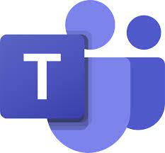



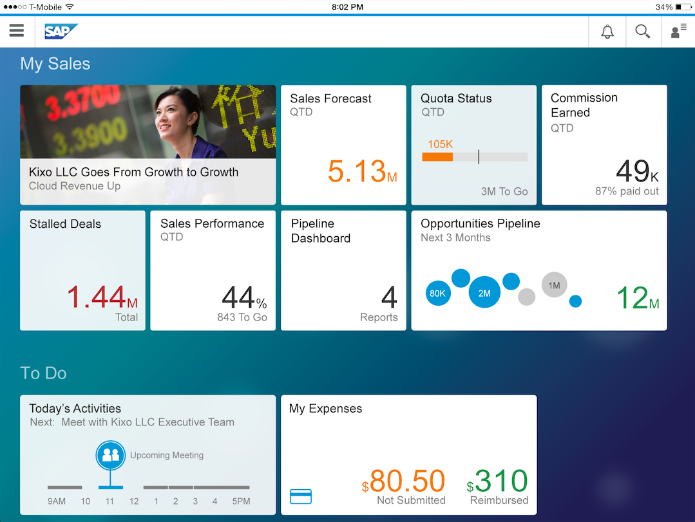

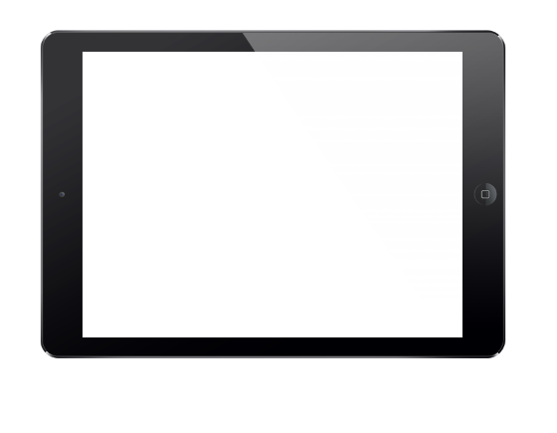
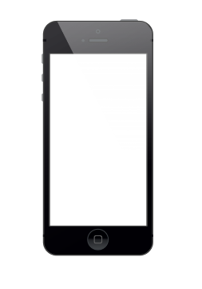

Architecture (Sales Cloud)
Inquiry
Document Generation
from CRM
i.e., Offer letter etc.
Email
Appointments
Visits
Convert to opportunity
Lead Creation
Opportunity info
Opportunity phases
Opportunity scoring
YES
Lead reports
Lead scoring
Activities
NO
Approval Matrix for various tasks such as opportunity conversion & Discounts.
Opportunity information pushed to CPQ for Quote Generation
CPQ
Notes
Information
Reasons
Intelligent sales forecasting
Pipeline management
Forecast tracker
Flow of customer data & accounts from ERP to CRM
Out of the Box Integration with 3rd Party Applications
ERP
Do your tasks on the move with mobile ready applications & features to increase efficiency even when mobile.

Slide 4






Architecture (Service Cloud)
Won Account
Customer Engagement
Notification sent to customer through preferred medium
Ticket Closed
Omnichannel Engagement
Ticket creation/
Service Order
Ticket completed
Service Order confirmation
Service billing created
(If applicable)
ERP
SLA Assigned
Chat Bot / Customer Service Agent
Billing information moved to ERP
CTI (computer telephony Integration) allows the service executive to make outbound/inbound calls to customers for gradiences & solutions.
Service Invoice sent to the customer for Payment
Ticket Management reports
Ticket Status reports
Real Time Analytics
Creation of tickets directly from MS Outlook
Integration with 3rd party BI tools for Service reports

